Slide 1




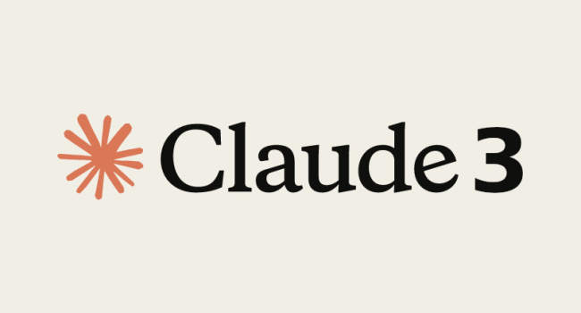

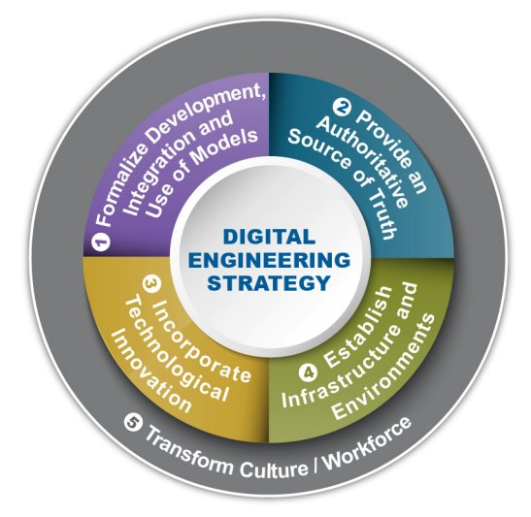
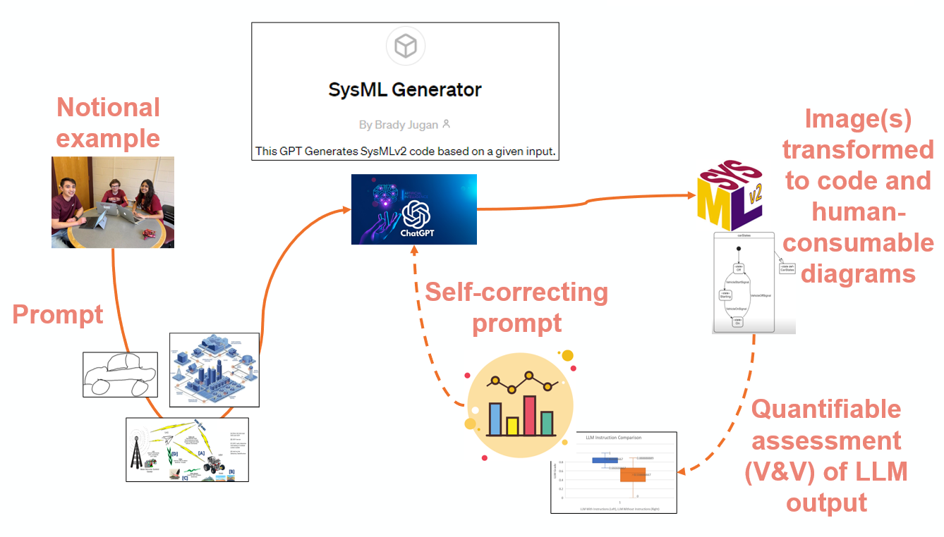
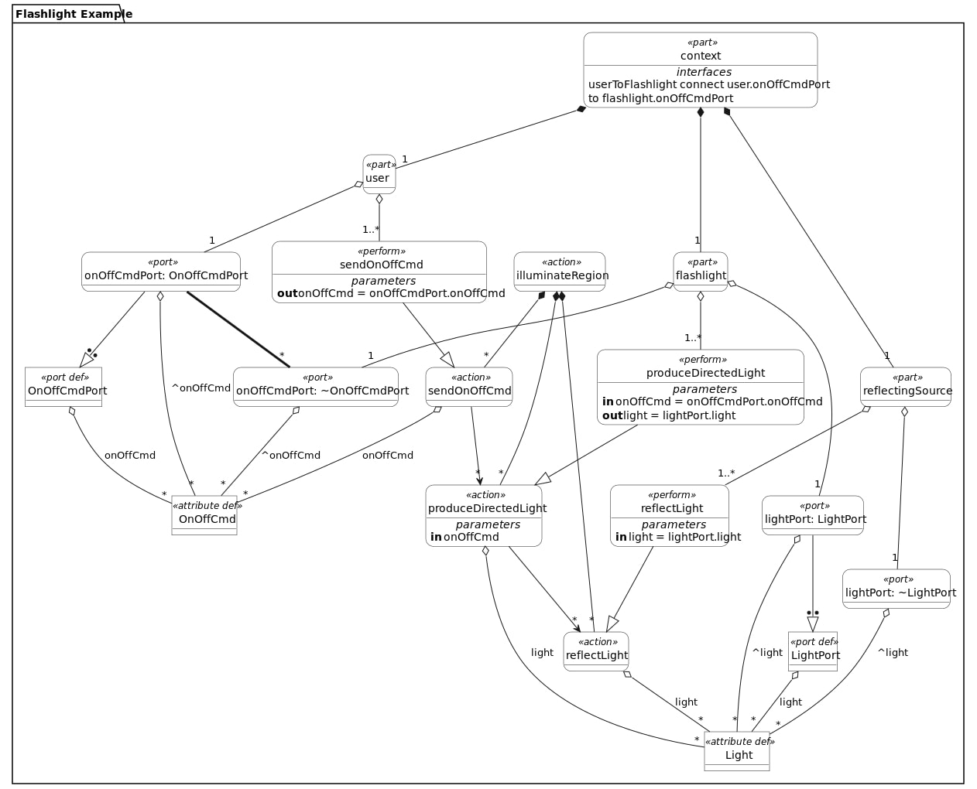
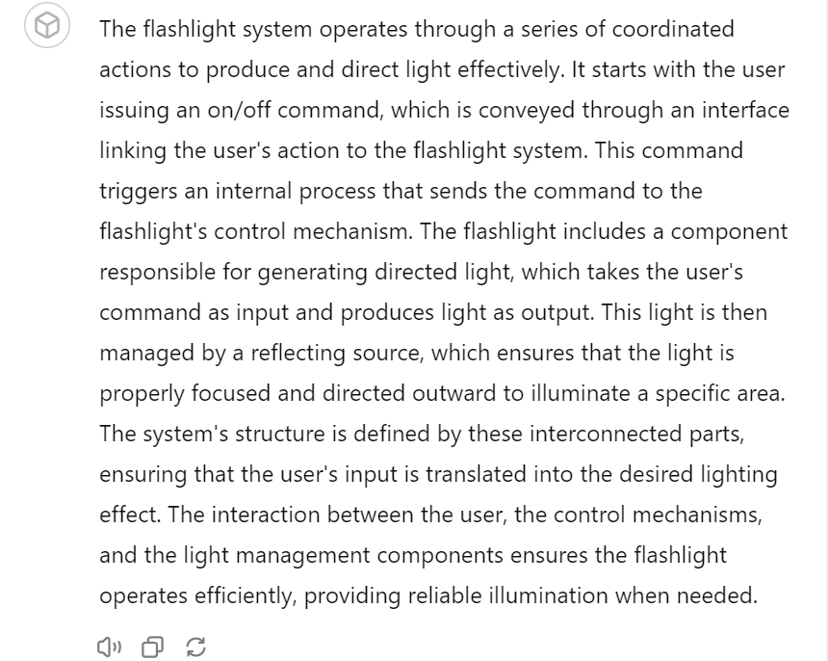
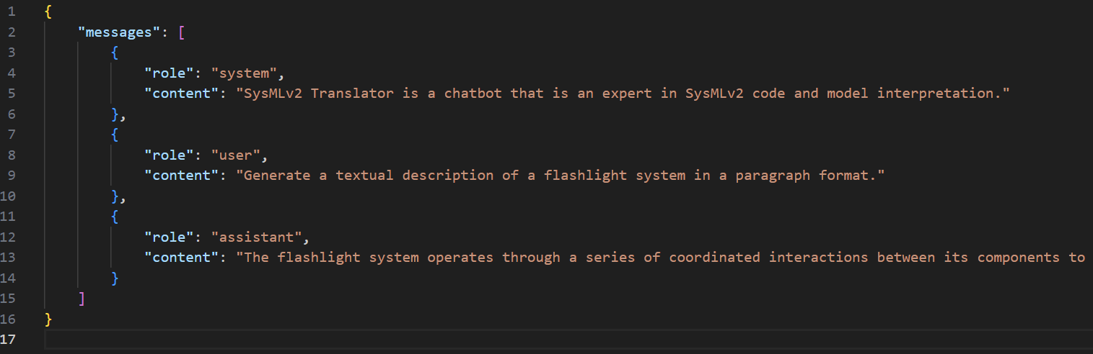
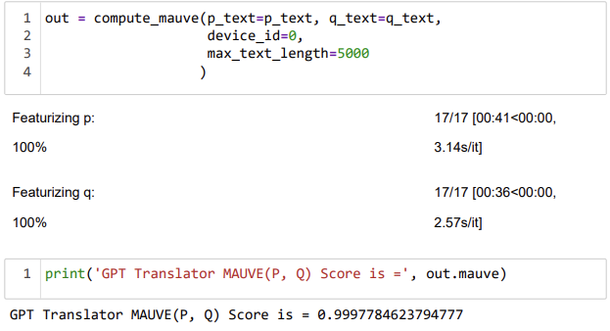
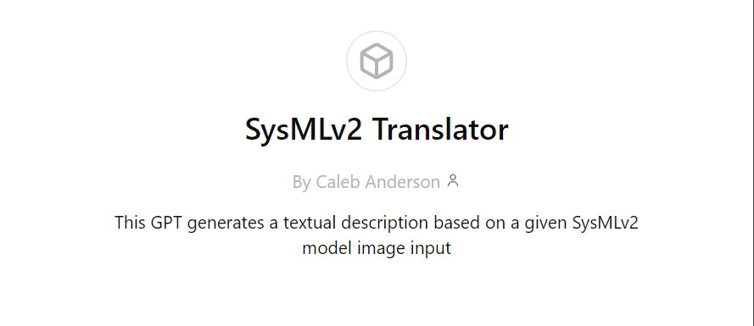



Model-Based Mission Engineering
PI: Dr. Paul Wach; co-PIs: Dr. Peter Beling
Students: CALEB ANDERSON, Trevor Ierardi, Brady Jugan, and Sanaz Shaik
Objective: Expedite and reimagine the digital transformation through generative AI, such as large language models (LLMs)
Model-Based Systems Engineering (MBSE)
Our initial focus has been on MBSE.
MBSE has seen a notable increase in emphasis over the last decade. The Systems Modeling Language version 2 (SysMLv2) offers a capability that is both textual (i.e., code) and graphical (i.e., human-consumable).
Large language models (LLMs) offer unique capabilities on tasks like code-generation, model-interpretation, and evaluation due to the large amounts of training.
We make use of these capabilities to generate SysMLv2 code from diagrams, images, and descriptions.
Additionally, we can leverage LLMs to translate SysMLv2 model visualizations to textual descriptions. Textual descriptions aid in validating that existing systems are modeled correctly according to expert knowledge.
The application of these measures allows us to bridge the knowledge gap between senior systems engineers, who have a deep understanding of systems and machines but limited technological expertise, and younger engineers who are proficient in SysMLv2.
Current focus:
LLM generated SysMLv2 code
LLM generated SysMLv2 model translation into system descriptions
Quantifiable metrics for verification & validation (V&V) of the LLM output (do we build it right & did we build the right thing?)
Looking Forward:
Rapid transformation of existing artifacts, processes, blueprints, etc.
Multi-model transformation
Expedite ​
&
Reimagine
Textual output
Image to code
prompt
Image to
text prompt
Using the MAUVE Framework, we can grade the output (as a percentage) and determine if the LLM was successful at translating the image.
Fine-tuned model consults the knowledge base to produce a textual output

